Slide 1

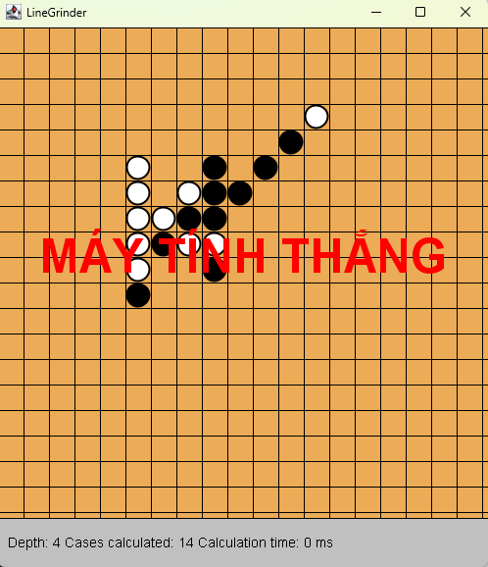

International University - Vietnam National University, HCM City
LineGrinder

Slide 2
International University - Vietnam National University, HCM City
MEMBERS
Phạm Thái Quốc - ITITWE21118
Ngô Trịnh Bảo Anh - ITITIU21154

Slide 3

TABLE OF CONTENTS
Introduction
01
Game Rules
02
Diagrams
03
Git Explanation
04
Lecture Applications
05
Limitation
06
Future Work
07
References
08

Slide 4



Introduction
Objective of the Project: Briefly explain the purpose of the game and its scope (e.g., adding AI vs. player mode).
Key Features: Highlight main features such as player-vs-player and player-vs-computer modes.
Technologies Used: Mention Java, Swing, and the Minimax algorithm.

Slide 5
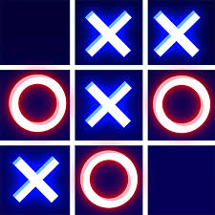

What is LineGrinder?
A strategy-based Connect5 game where players aim to align five consecutive stones on a grid.
Our Objective :
Minimax Algorithm with Alpha-Beta Pruning: Efficiently calculates the best moves by evaluating possible game states.
Optimized Decision-Making: Balances complexity and performance for competitive gameplay.
Interactive and user-friendly interface for an engaging player experience.

Slide 6


Slide 7
Game Rules
Objective:
Aligning five consecutive pieces (horizontally, vertically, or diagonally) to win the game.
Gameplay
Winning Conditions
Timer Option (Optional)
Two players ( Human vs Bot ) take turns placing their pieces on the grid.
The board size is customizable (e.g., 10x10, 15x15).
Players must strategize to block opponents while creating their winning line.
A player wins immediately after forming a line of five consecutive pieces.
No additional moves are allowed once a winner is declared.
Players have limited time to make their move, adding intensity and strategic pressure.

Slide 8


Slide 9

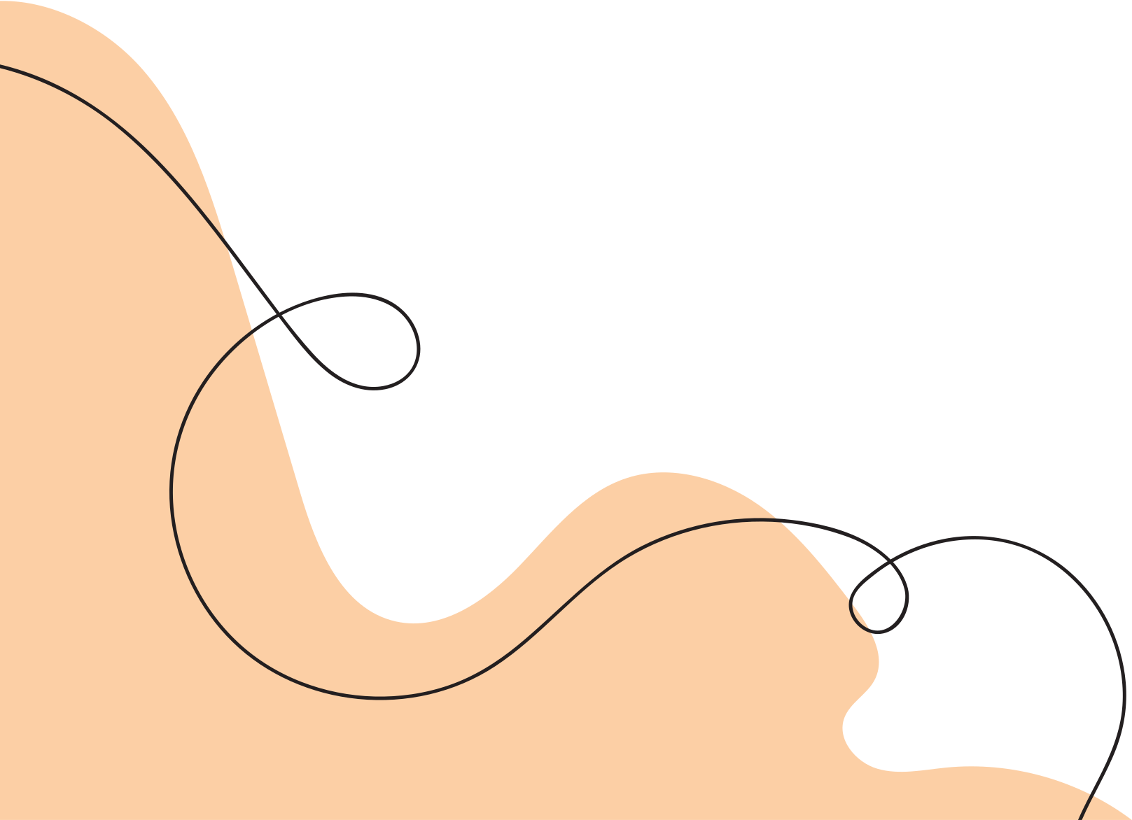
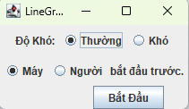


Slide 10
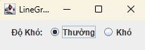

PLAYER VS BOT
HOW TO PLAY
Picking Difficulty: Medium-Hard
Align five consecutive stones (horizontal, vertical, or diagonal) on the grid to win.
Picking turns as for which to go first

Slide 11
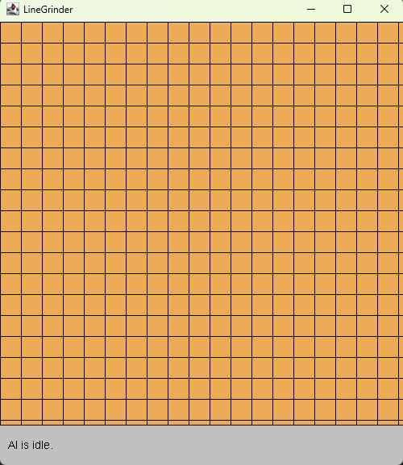
INTO THE GAME

Slide 12

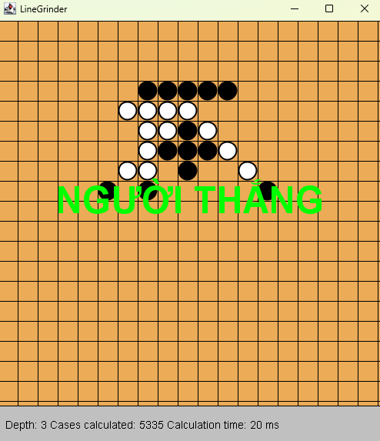

HUMAN WIN
COMPUTER WIN

Slide 13

01
Minimax Algorithm
02
Heuristic Evaluation
Algorithms
03
Backtracking
04
Winning Move Search

Slide 14
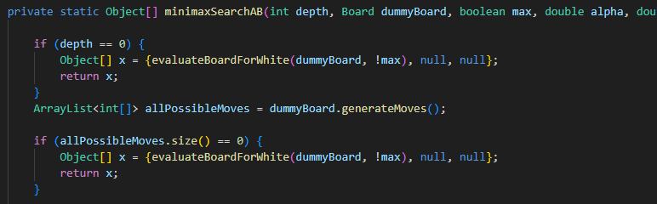
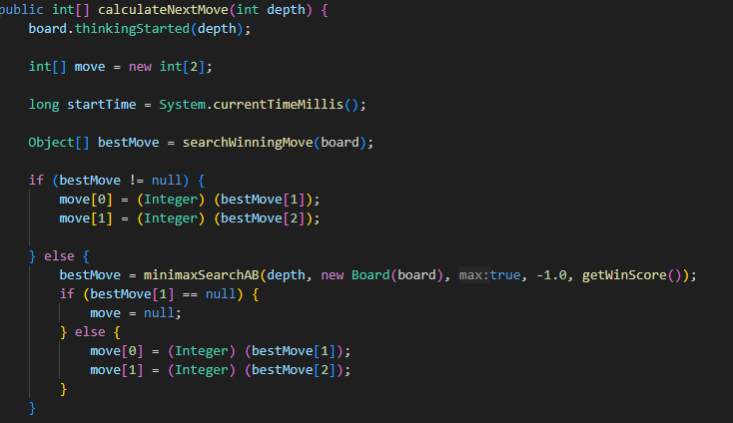
Minimax
Time Complexity: O(b^d)
b: size of the board
d: depth
Implements the Minimax algorithm with Alpha-Beta Pruning.
Simulates moves, evaluates their outcomes, and prunes branches where further exploration isn’t beneficial.
calculateNextMove(int depth): Determines the best move for the AI. Uses minimaxSearchAB to compute the best move.

Slide 15
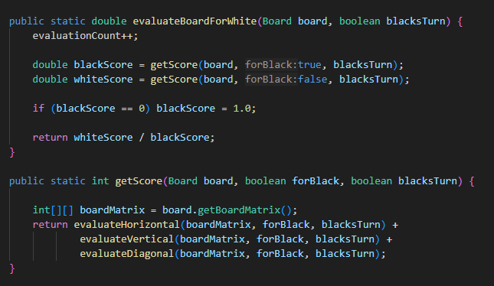
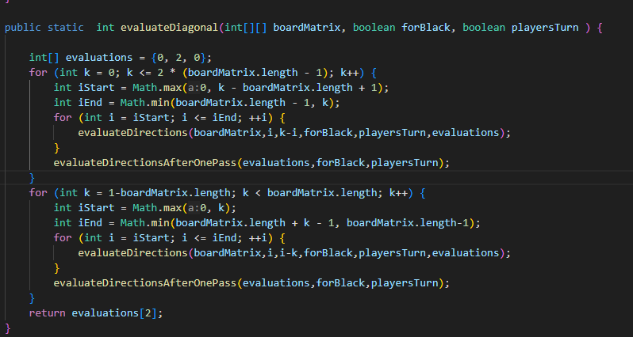
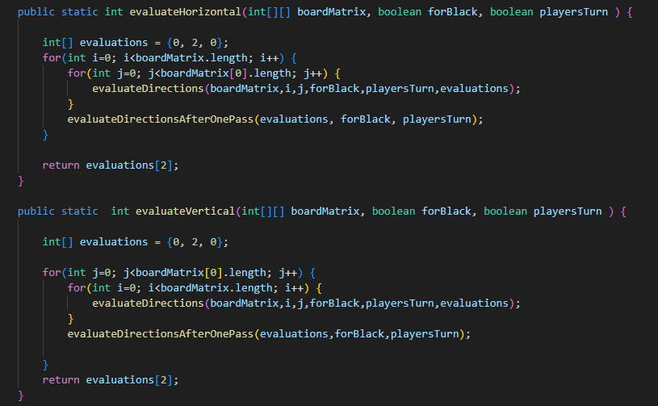
Heuristic Evaluation
evaluateBoardForWhite()
getScore()
evaluateHorizontal, evaluateVertical, evaluateDiagonal: Evaluate scores for specific alignments on the board.
getConsecutiveSetScore(): Calculates scores for consecutive stones and accounts for blocked paths.

Slide 16
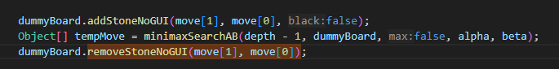
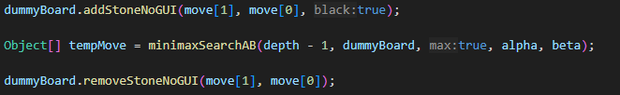
Backtracking
addStoneNoGUI removeStoneNoGUI:
Simulate and revert moves during recursive exploration.

Slide 17
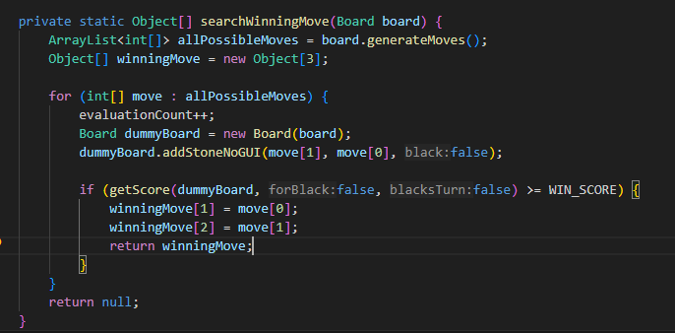
Winning Move Search
Quickly determines if there’s a move that immediately results in a win.

Slide 18
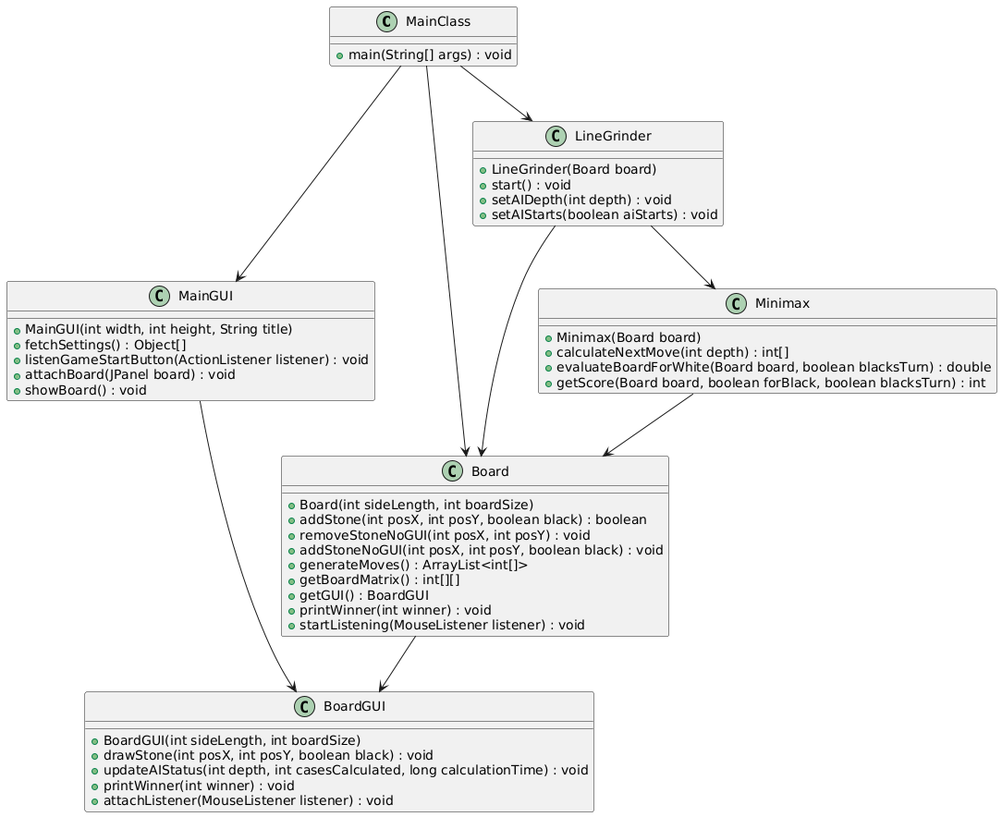
UML Diagram

Slide 19
Git Explanation
Version Control
Collaboration via GitHub
Workflow
Benefits
Git was used to manage version control, ensuring all changes were tracked and merged smoothly.
The team used GitHub to store and share the project. Members cloned, edited, and pushed changes, enabling real-time collaboration.
Clone: Each member cloned the repository to start working.
Commit: Changes were committed with clear messages.
Push/Pull: Changes were pushed to the central repo and pulled to sync with others.
Collaboration: Enabled parallel development.
Tracking Changes: Git’s history allowed easy tracking and reverting of changes.
Conflict Resolution: Git tools helped resolve merge conflicts without losing work.

Slide 20

Lecture Applications
Object-Oriented Programming
Algorithms Applications
Design Patterns
Java and Swing
Encapsulation: Manages game states with clear interfaces (Board, LineGrinder).
Inheritance & Polymorphism: Flexible event handling (MouseListener).
Abstraction: Core game logic abstracted into modular components (e.g., Board, Minimax) for efficient management and scalability.
Factory Pattern: Simplifies creation of players and game configurations.
Singleton Pattern: Ensures consistent AI state in Minimax.
Java’s OOP features helped build modular, reusable game components.
Swing was used for creating an intuitive, interactive GUI.
Minimax with Alpha-Beta Pruning: Makes smart decisions by looking ahead.
Game Scoring: Calculates moves and outcomes effectively.
Performance Metrics: Tracks speed and efficiency.

Slide 21


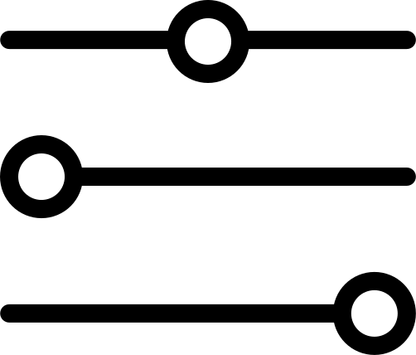


Limitation
Basic AI Strategy: The AI uses fixed rules and doesn’t adapt to new strategies.
Slow at Higher Depths: The AI takes more time for complex calculations on larger boards.
No Learning: The AI doesn’t improve or learn from past games.
Simple Design: The game interface is basic and lacks advanced features.
Single-Player Only: The game is focused on playing against AI, with no multiplayer option.

Slide 22

Smarter AI: Add adaptive strategies to make the AI more challenging.
Learning AI: Include machine learning to let the AI get better with experience.
Faster Algorithms: Use better methods to speed up AI decisions.
Improved Design: Add features like move suggestions, themes, and stats.
Multiplayer Mode: Create a way to play with friends or online.
Mobile Version: Make the game available on phones and web browsers.

Slide 23

REFERENCES
https://www.geeksforgeeks.org/finding-optimal-move-in-tic-tac-toe-using-minimax-algorithm-in-game-theory/?utm_source=chatgpt.com
https://github.com/vmsaif/connect4-with-minimax-algorithm-in-java?utm_source=chatgpt.com
https://github.com/rchen8/connect-five

Slide 24

THANK YOU!
Q&A TIME <3

